Slide 1
University Application System(easy Apply)
Project Demo
Srivishnu Alvakonda
TLEN 5841-001(Spring 2017)
University of Colorado Boulder

Slide 2
Actor’s:
University Application System
Student
University
Consultant
Recommender
Admin
Description:
Designing a Secure web application for University Applications which allows student(Grad/Undergrad) to send single application to multiple universities. This application takes care of Actor’s privacy by providing authentication, XSS protection, SQLi protection.

Slide 3
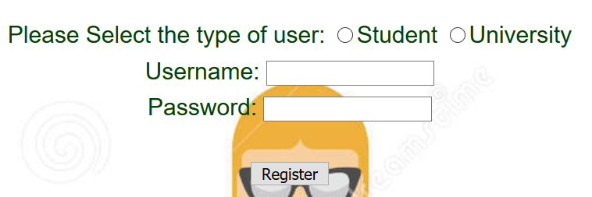
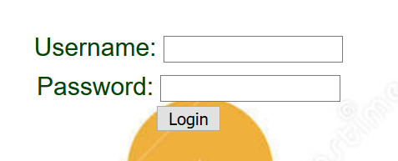
Registration and Login

Slide 4
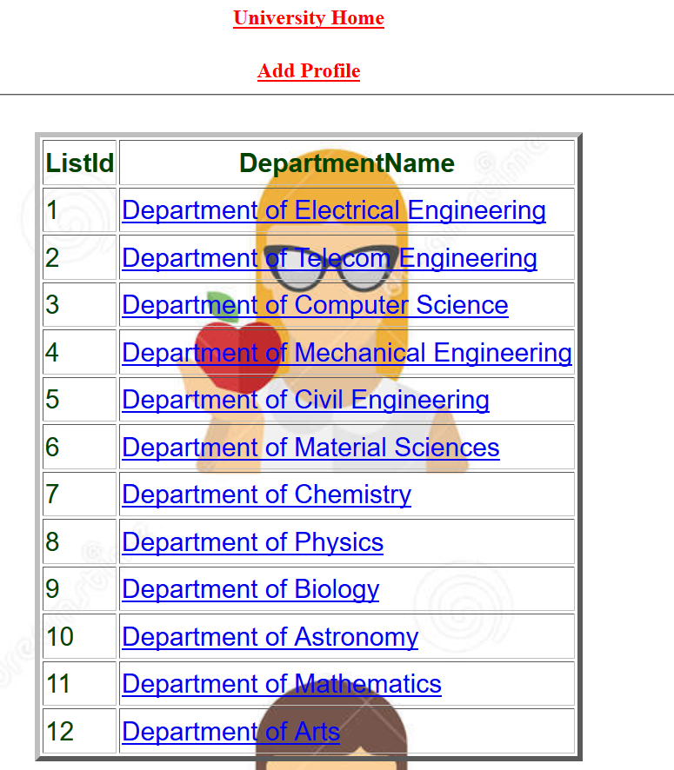
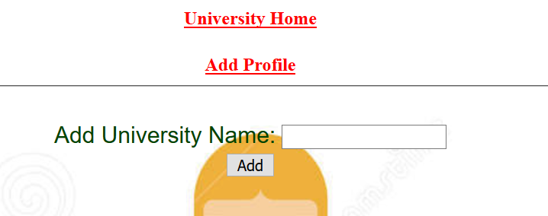
University Logged in:

Slide 5
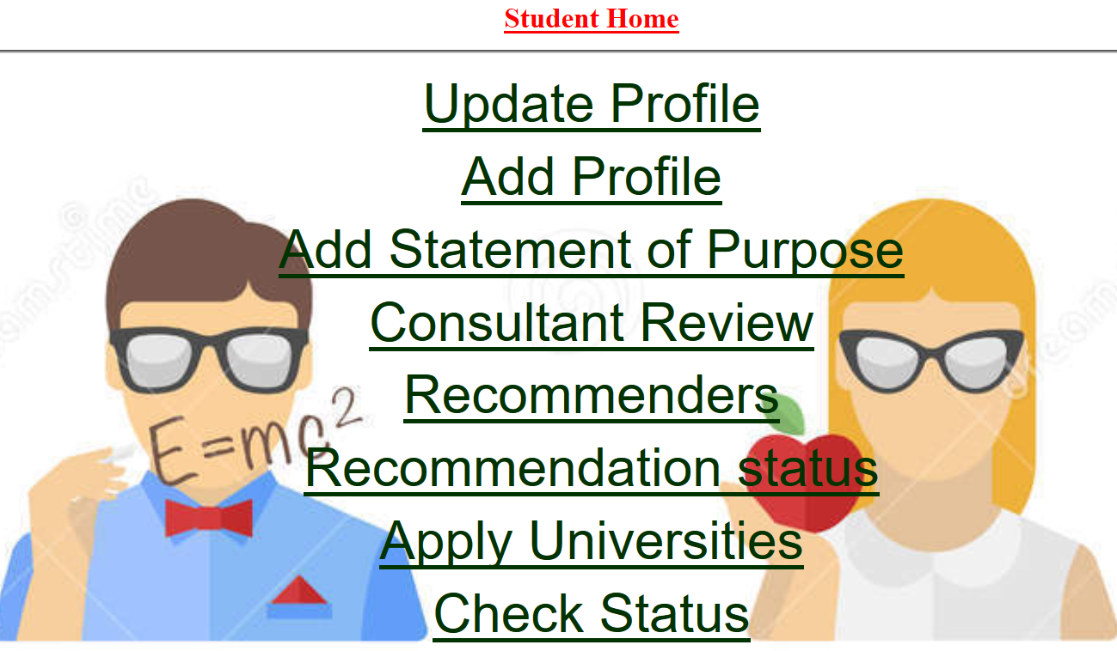
Student logged in:
University Application System

Slide 6
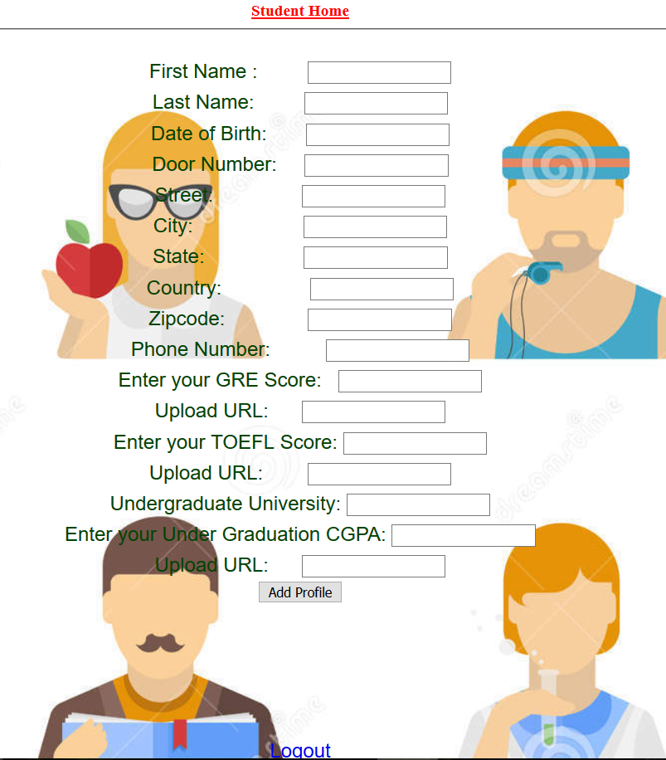
Student adds profile information:

Slide 7
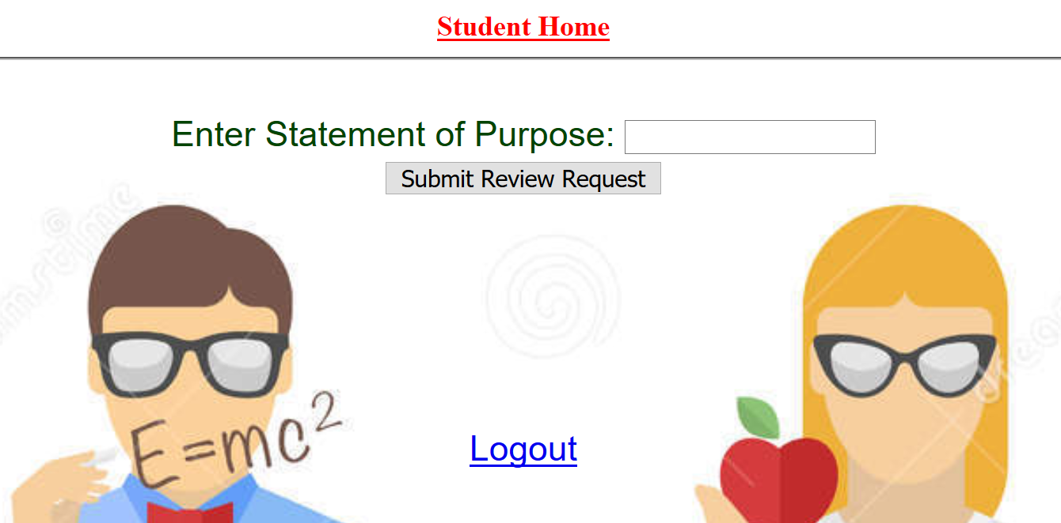
Student Enters SOP:

Slide 8
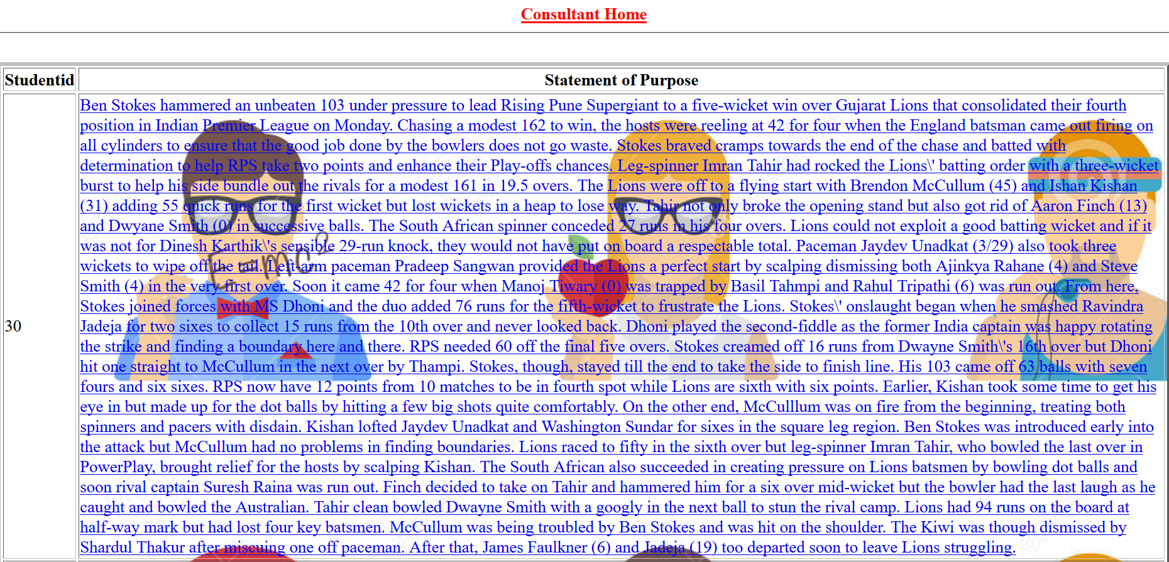
Consultant logged in:

Slide 9
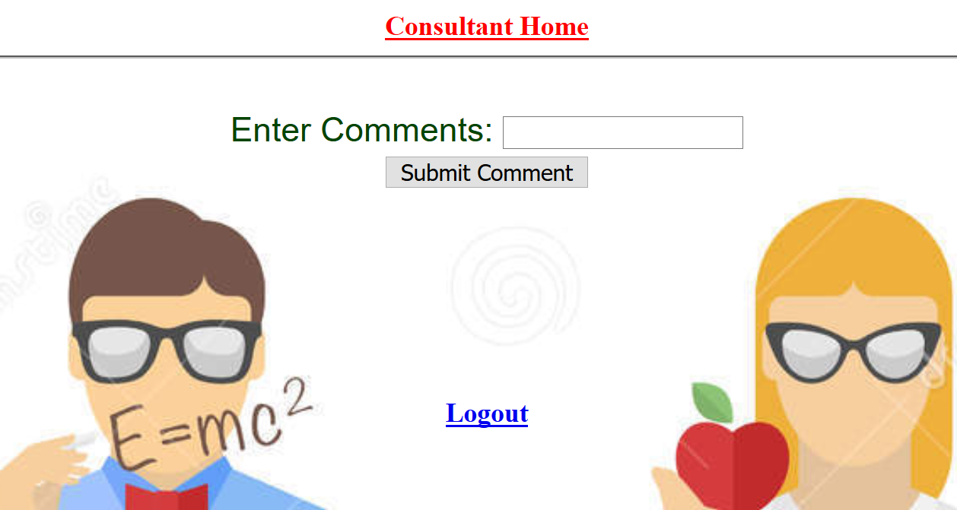
Consultant adds comments:

Slide 10
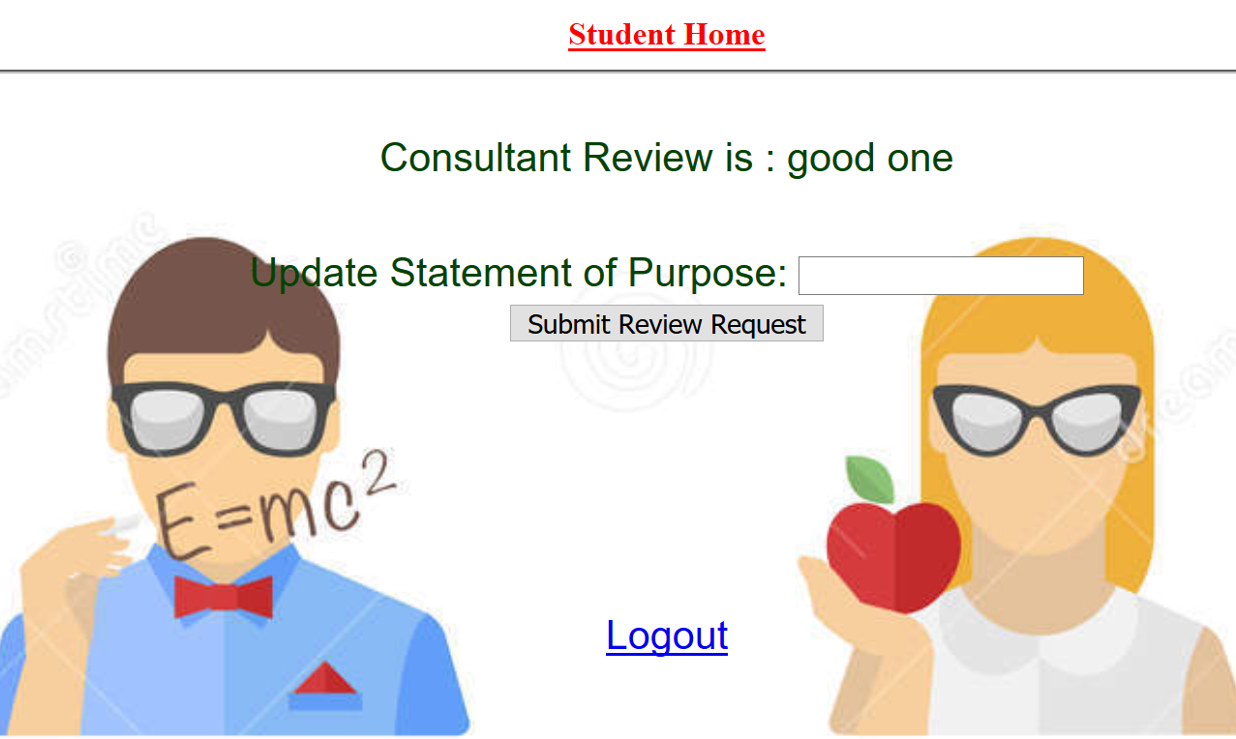
Student reviews comments:

Slide 11
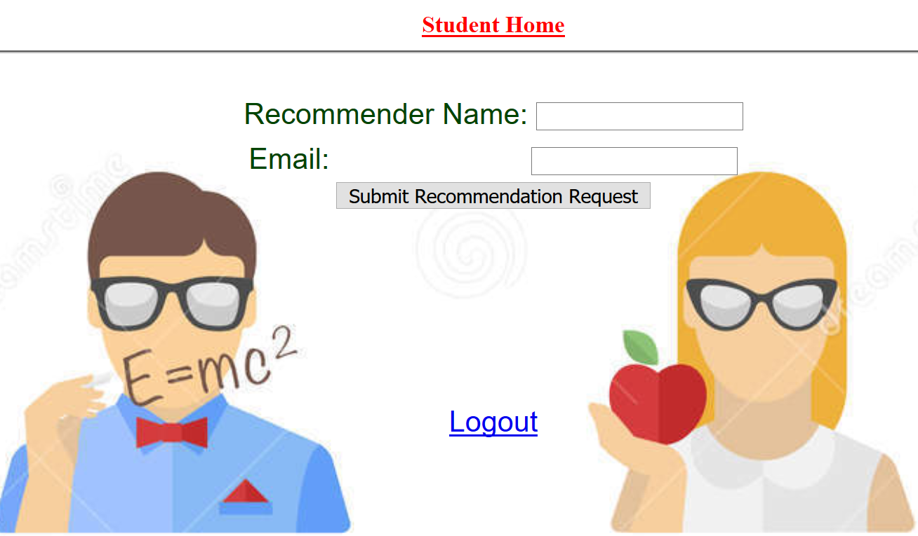
Student requests Letter of Recommendation:

Slide 12
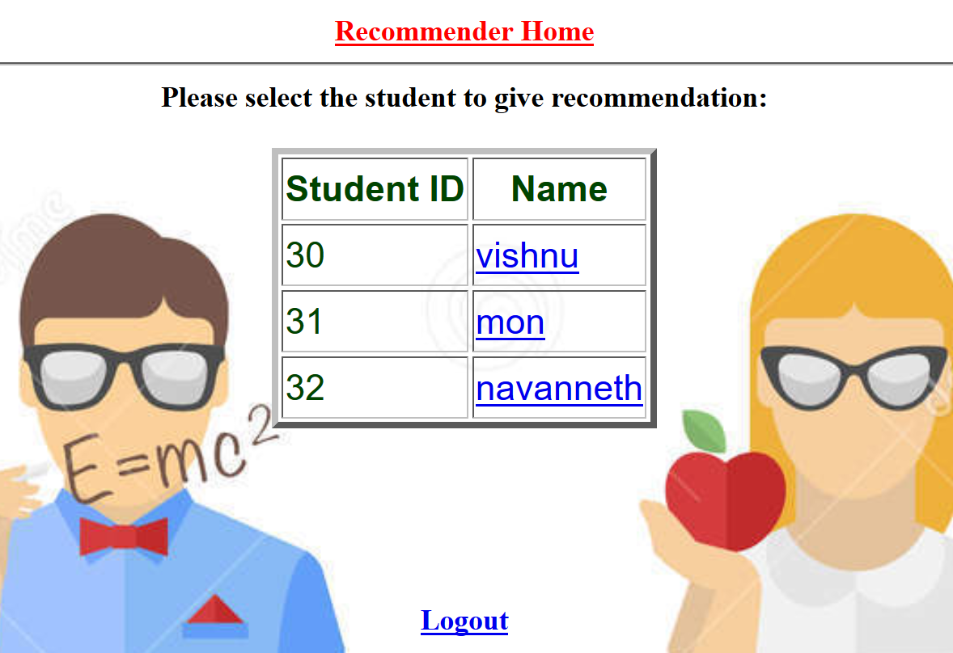
Recommender logged in:

Slide 13
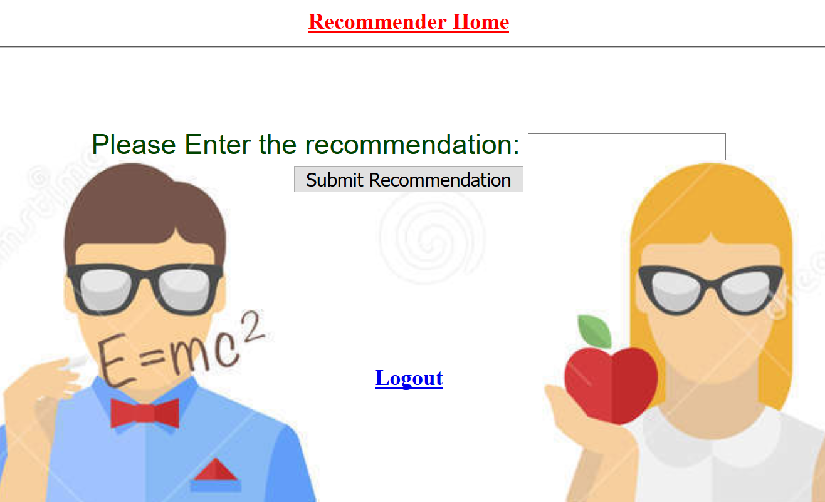
Recommender gives LOR:

Slide 14
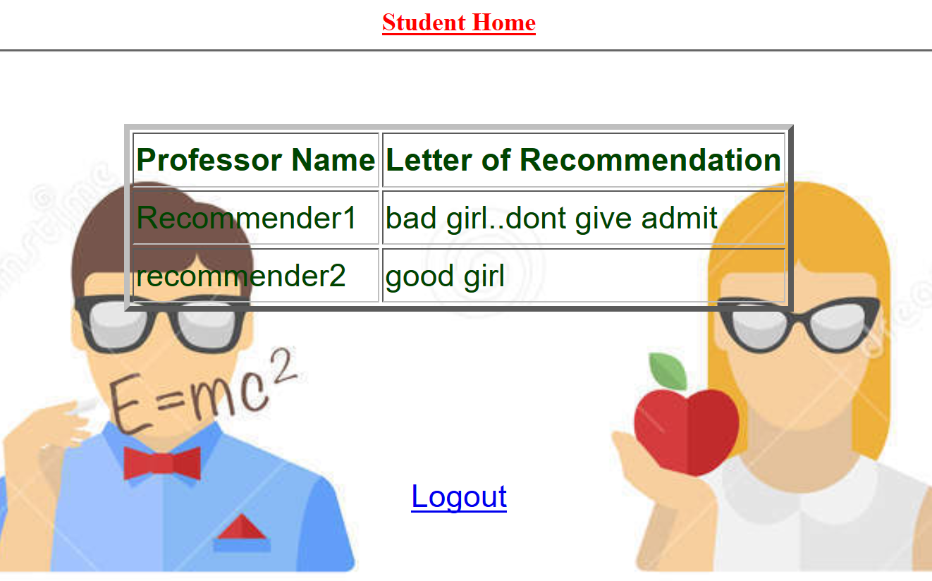
Student checks LOR Status:

Slide 15
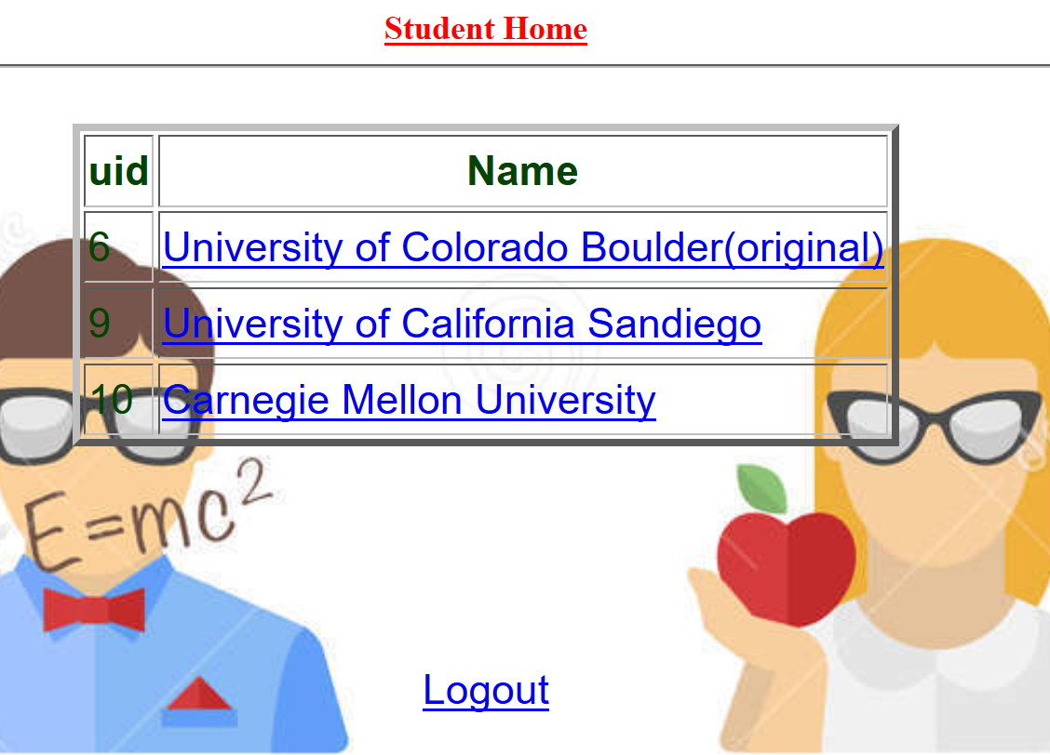
Student Selects Universities to Apply:

Slide 16
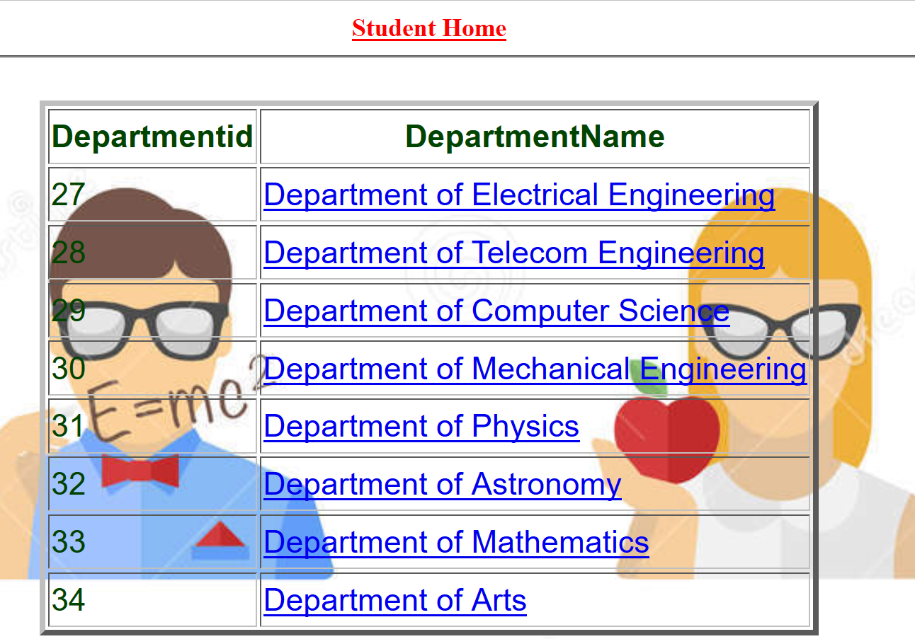
Student Selects Department to Apply:

Slide 17
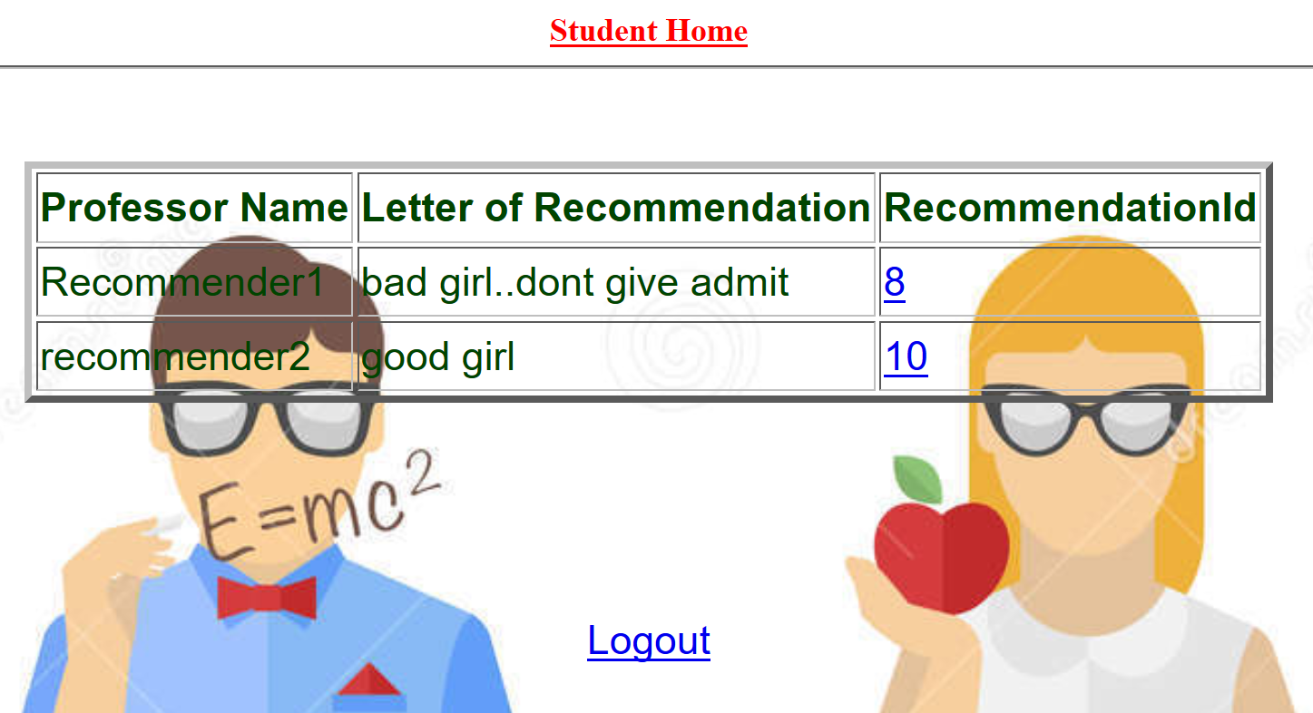
Student chooses LOR to Send:

Slide 18
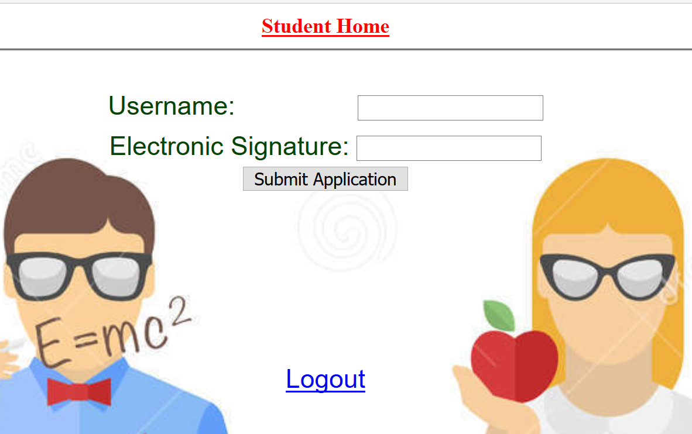
Student Submits Application:

Slide 19
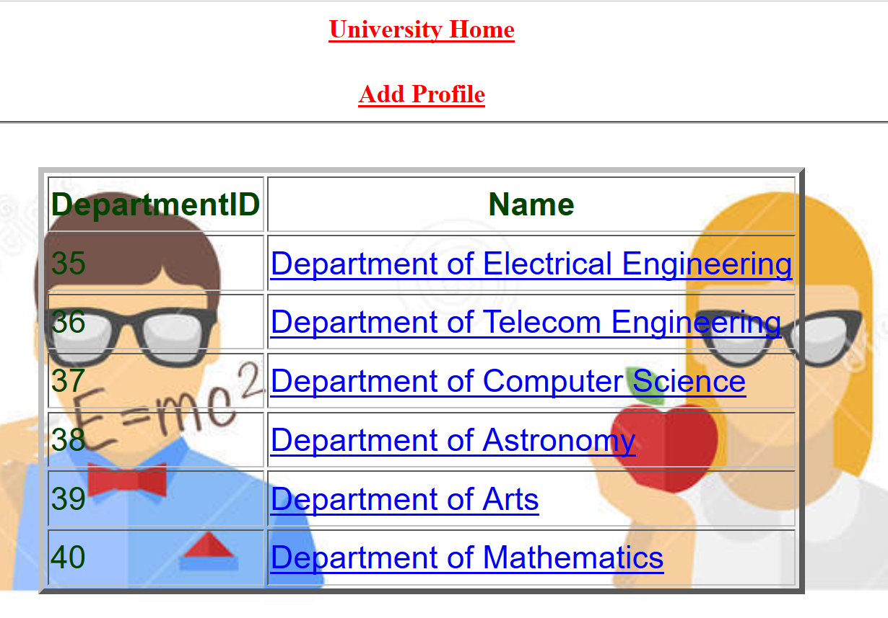
University Logged in and chooses department:

Slide 20
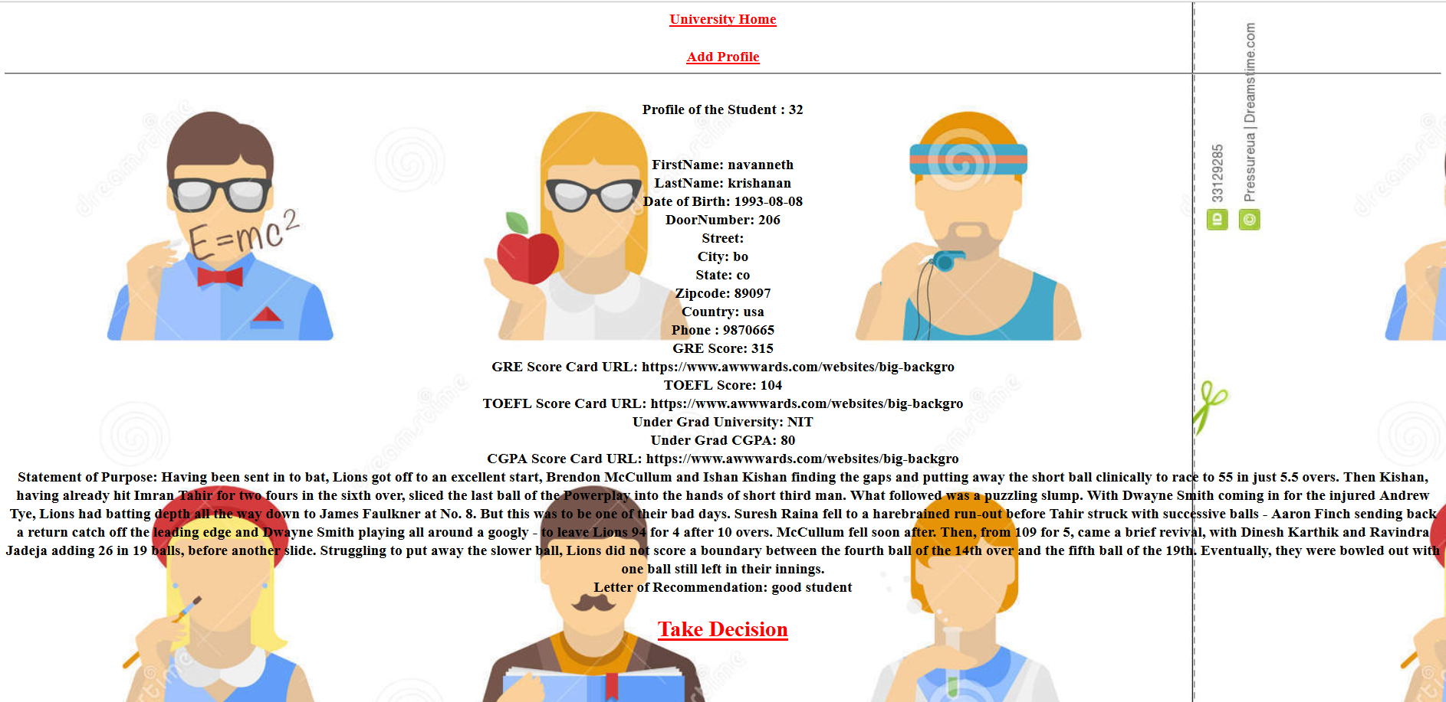
University Reviews Student Profile

Slide 21
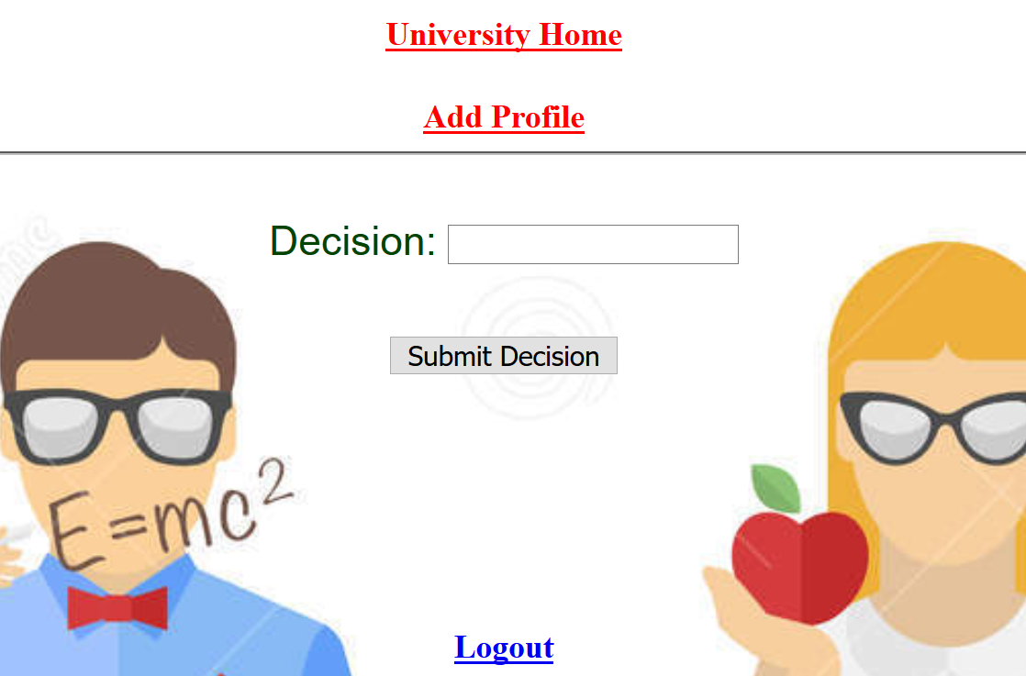
University takes decision:

Slide 22
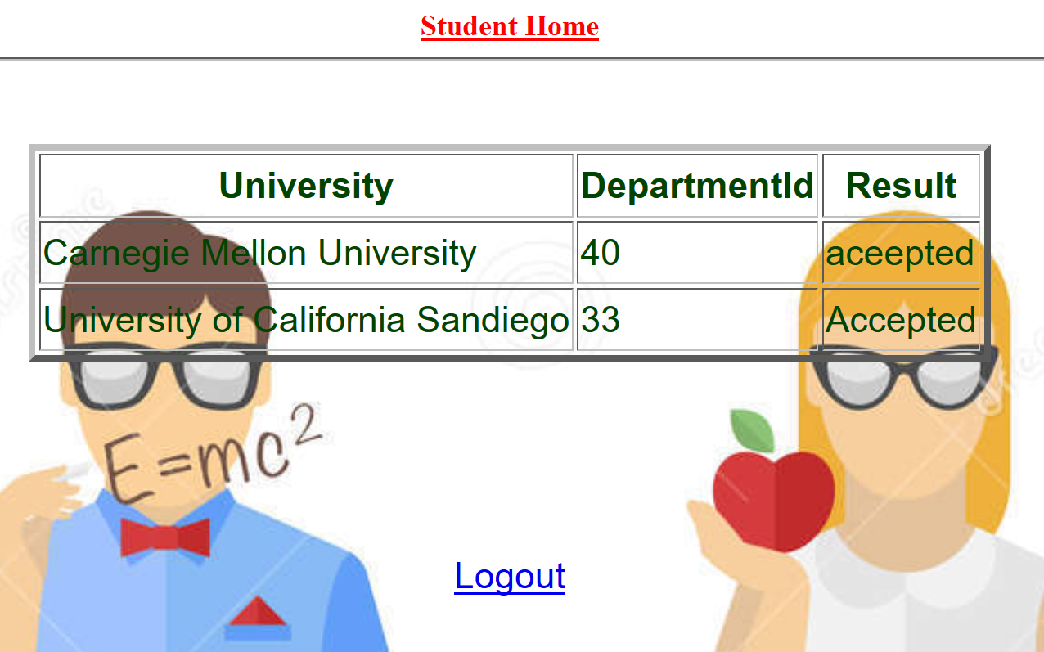
Student checks Application Status:

Slide 23
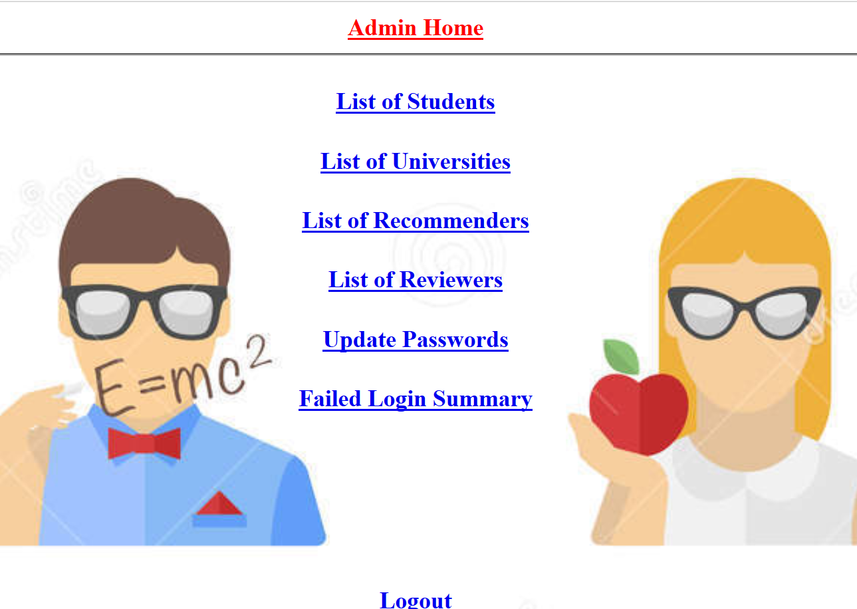
Admin functionalities:

Slide 24
THANK YOU

